Slide 1

Unlocking Growth: Your Guide to Olist Store Welcome! Today we'll explore how Olist can help you build a thriving online store and expand your business reach By :

Slide 2






Table of Contents
Introduction
Project Overview
KPI’s
Dashboards
Conclusion

Slide 3

Introduction
Overview : This project provides an in-depth analysis of Olist store data, leveraging tools like Excel, MySQL, Power-BI and Tableau. Olist is a comprehensive e-commerce platform designed to connect small and medium-sized businesses with a broader customer base through its marketplace. By offering a centralized system for sellers to manage their products, inventory, and customer interactions, Olist simplifies the complexities of online retail. Objectives : Seamless Integration : Enabling business to list their products on multiple marketplace simultaneously Enhanced Logistics : Offering end-to-end solution for shipping and delivery to improve customer satisfaction Data-Driven Insights : Leveraging customer and sales data to optimize performance, marketing strategies and inventory management

Slide 4
02
Project Overview
Overview : This project aims to analyze the performance of Olist, an e-commerce platform that facilitates businesses in reaching wider audiences and optimizing their operations. Key Focus Areas :
1] Sales Performance:
Analyze total sales and profit trends.
Identify top-performing product categories and customer segments.
2] Customer Insights:
Evaluate unique customer behavior and preferences.
Highlight repeat customers and their contribution to revenue.
3] Operational Efficiency:
Assess delivery timelines and shipping methods.
Understand the impact of logistics on customer satisfaction.
4] Payment Trends:
Review payment types and their popularity among customers.

Slide 5
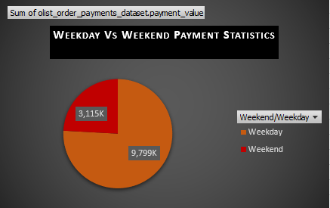
KPI-1
03
Weekday Vs Weekend (order_purchase_timestamp) Payment Statistics
Order Behavior:
Weekdays vs. Weekends: Analysis reveals that weekdays see higher order volumes, with a peak on Monday and a gradual decline towards midweek. This trend indicates that customers are more active during weekdays, suggesting an opportunity for targeted promotions.

Slide 6
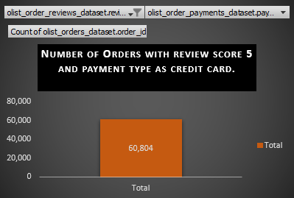
KPI-2
03
Number of Orders with review score 5 and payment type as credit card.
Payment Preferences:
Dominance of Credit Cards: Credit cards are the preferred payment method, especially for 5-star reviews, followed by boleto. This highlights the importance of secure and convenient payment options in driving customer satisfaction.

Slide 7
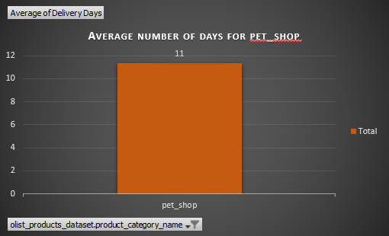
KPI-3
03
Average number of days taken for order_delivered_customer_date for pet_shop
Delivery Times:
Category Variations: Office furniture has the longest delivery time, while arts and craftsmanship have the shortest. On average, deliveries take 12 days, with pet shop products averaging 11 days. Streamlining delivery processes for categories with longer times could enhance overall efficiency.

Slide 8
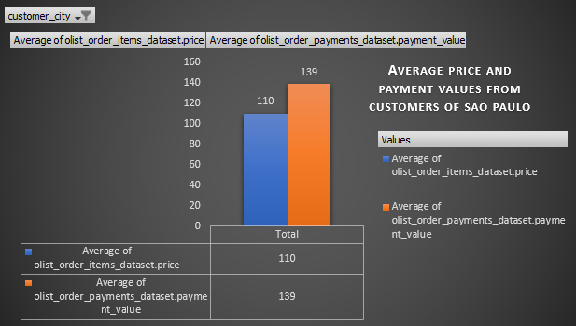
KPI-4
03
Average price and payment values from customers of sao paulo city
Geographical Insights:
City-wise Trends: Sao Paulo and Rio de Janeiro record the highest order counts. In Sao Paulo, the average payment surpasses the average price, likely due to high order density. Tailored marketing strategies for these regions could further boost sales.

Slide 9
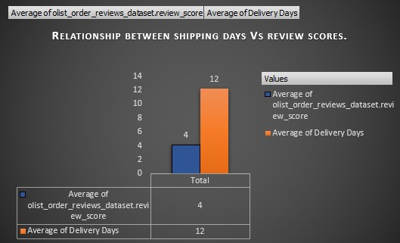
KPI-5
03
Relationship between shipping days (order_delivered_customer_date - order_purchase_timestamp) Vs review scores
Shipping Duration and Reviews:
Negative Correlation: A clear negative correlation exists between shipping duration and review scores. Faster shipping times are associated with higher review scores, emphasizing the need for efficient logistics.

Slide 10
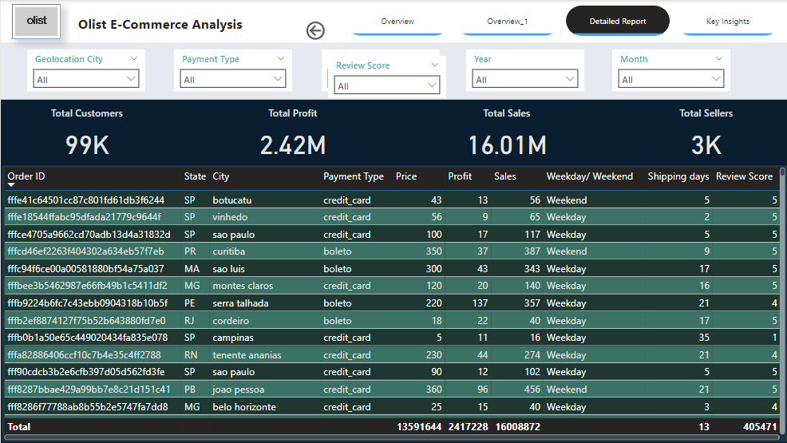
Power-BI Dashboard
04

Slide 11
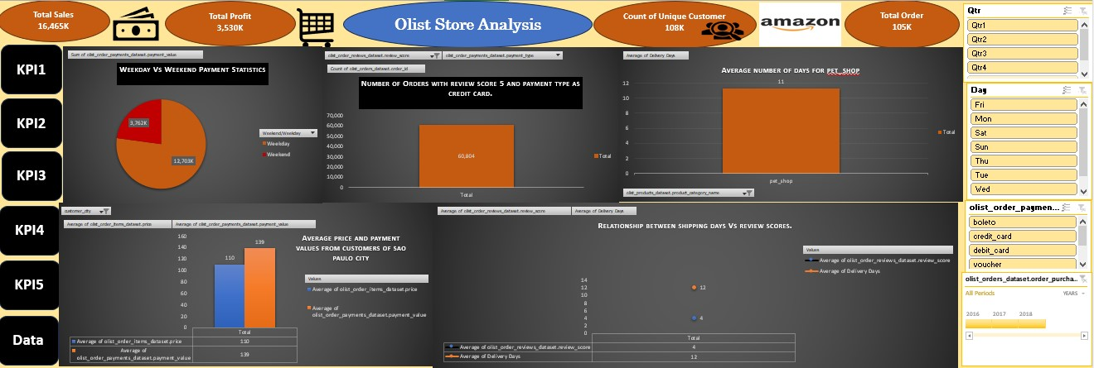
Excel Dashboard
04

Slide 12
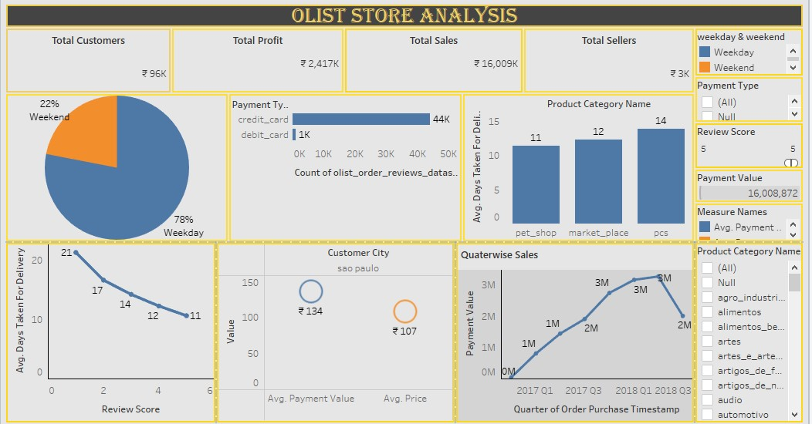
Tableau Dashboard
04

Slide 13
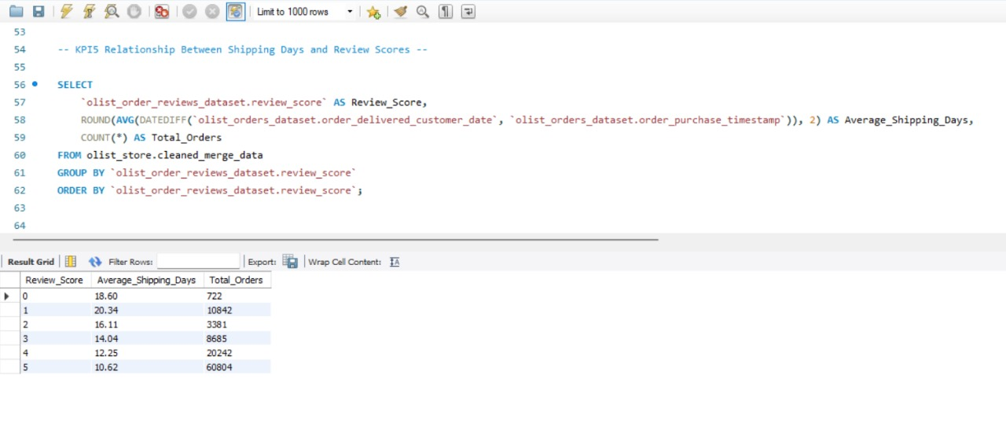
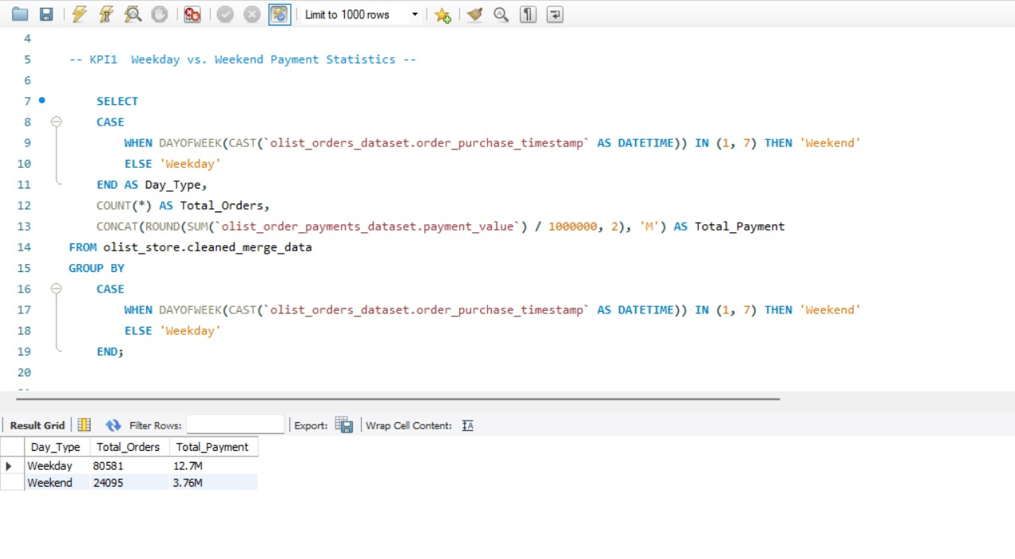
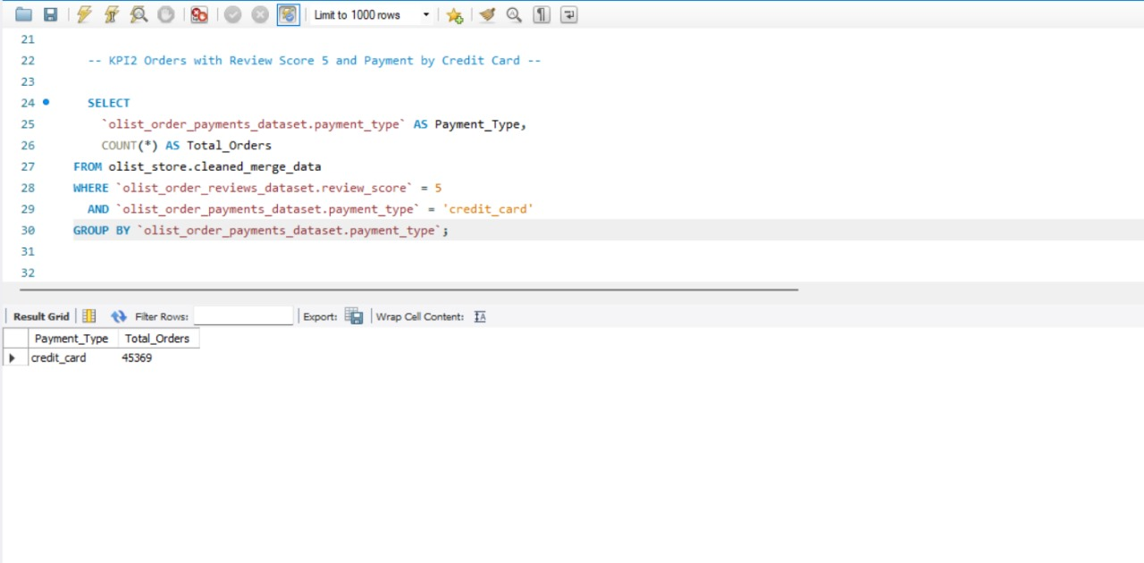
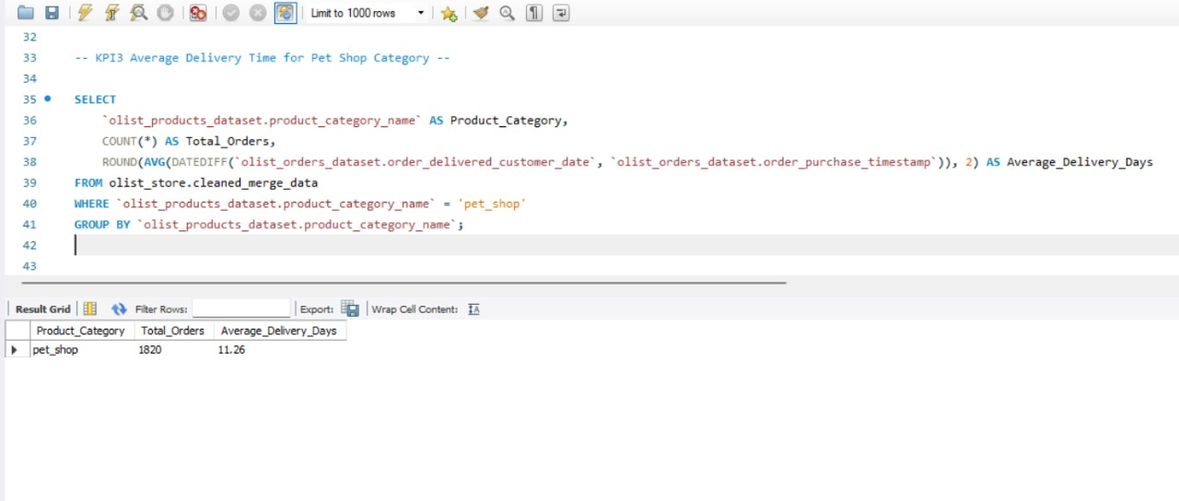
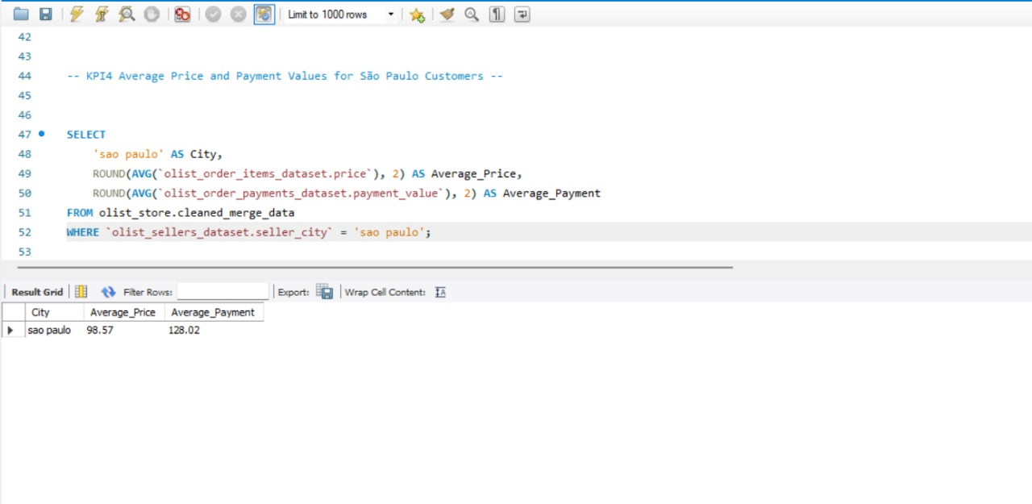
MySQL Queries
04

Slide 14
Conclusion
05
The analysis of the Olist store's performance provides valuable insights into its operations, customer behavior, and overall efficiency. Here are the key takeaways:
1] Sales and Profitability:
Olist has a strong revenue base driven by diverse product categories.
Top-performing products and customer segments contribute significantly to profitability, highlighting areas for targeted marketing.
2] Customer Insights:
The store serves a wide range of customers, with unique and repeat buyers playing vital roles in sustaining growth.
Understanding customer preferences and enhancing engagement strategies can further improve customer retention and satisfaction.
Recommendations:
Invest in marketing campaigns for top products and key customer segments.
Optimize delivery and logistics to reduce delays and boost customer satisfaction.
Use data-driven insights to plan promotions during peak periods.
Expand payment options to accommodate diverse customer preferences.
By leveraging these insights, Olist can continue to grow as a leading e-commerce platform, delivering value to both sellers and customers while optimizing its operations for sustained success.

